Slide 1
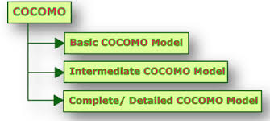
Module – IV : COCOMO
Software Engineering (SE) → CSEN 3202 – CSE/Btech/6th Semester → Module-IV → Prepared by : Nilina Bera, CSE, HITK

Slide 2
Organic, Semidetached and Embedded software projects
Boehm postulated that any software development project can be classified into one of the following three categories based on the development complexity: organic, semidetached, and embedded.
In order to classify a product into the identified categories, Boehm not only considered the characteristics of the product but also those of the development team and development environment.
Roughly speaking, these three product classes correspond to application, utility and system programs, respectively.
Normally, data processing programs are considered to be application programs. Compilers, linkers, etc., are utility programs.
Operating systems and real-time system programs, etc. are system programs.
System programs interact directly with the hardware and typically involve meeting timing constraints and concurrent processing.
Nilina Bera

Slide 3
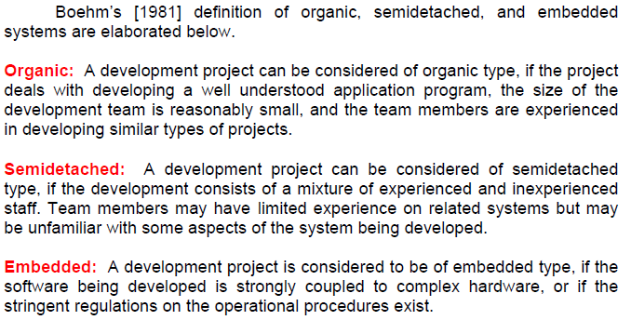
Organic, Semidetached and Embedded software projects
Example:
Organic: Application programs, web-site development, data processing programs, e.g., software that processes large volume of data using simple algorithms, payroll software that computes salaries of the employees and print cheques for them… (small in size, 50 KLOC)
Semi detached: Utility programs, e.g., Compilers, linkers. (size > 300 KLOC)
Embedded: Operating systems and real time system programs. These directly interacts with h/w and meet timing constraints and concurrent processing. (size not more than 300 KLOC)
Nilina Bera

Slide 4
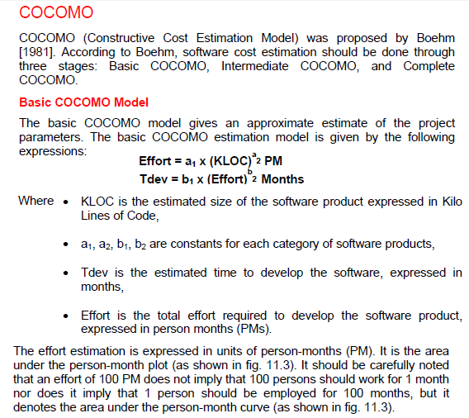
Nilina Bera

Slide 5
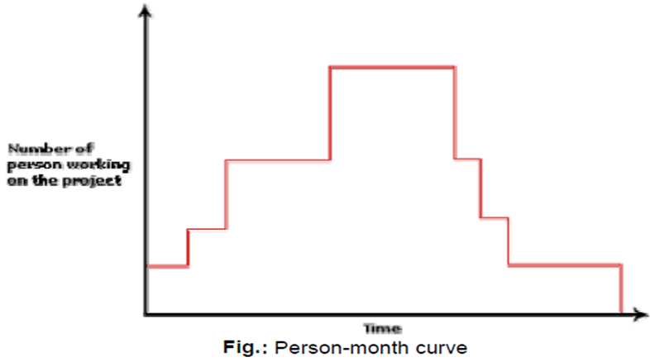
Person Month (needed in Effort Estimation)
Effort estimation is expressed in units of person-months (PM). The PM-unit indicates typically the work done by one person working on the project for one month.
Note: An effort estimation of 100PM does NOT imply that 100 persons should work for 1 month. Neither does it imply that 1 person should be employed for 100 months.
The effort estimation simply denotes the area under the person-month curve for the designated project, where different number of personnel may work at different point in the project development as followed in practical industry scenario.
Nilina Bera

Slide 6
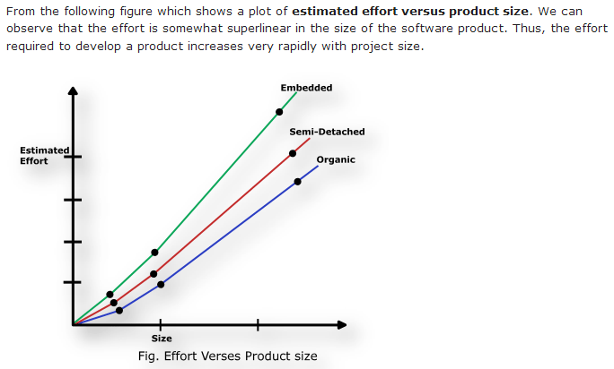
Basic COCOMO
Nilina Bera

Slide 7
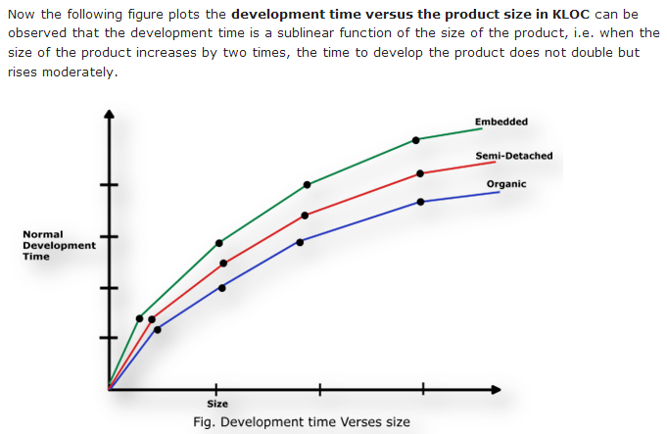
Basic COCOMO
Nilina Bera

Slide 8
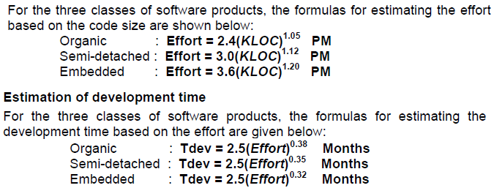
Estimation of development effort & time
Nilina Bera

Slide 9
Examples :-
1. Assume that the size of an organic type software product has been estimated to be 32,000 lines of source code. Assume that the average salary of software engineers be Rs. 15,000/- per month. Determine the effort required to develop the software product and the nominal development time.
From the basic COCOMO estimation formula for organic software:
Effort = 2.4 х (32)^{1.05} = 91 PM
Nominal development time = 2.5 х (91)^{0.38} = 14 months
Cost required to develop the product = 14 х 15,000 = Rs. 2,10,000/-
2. Your team is asked to develop critical software of health insurance system, as the project is complex and sensitive related to the Insurance of health so there is no chance of error. If the size of the project is 33200 LOC then calculate the “Effort” in person month, and “Time” required to develop (Schedule) the Software in months, with the number of people required to complete the project using “Organic Development Mode”. What is the cost required to develop the software assuming that average salary of software engineers be 25,000/- per month? [Assume, Effort constants: a1=2.4, a2=1.05; Development Time constants: b1=2.5, b2=0.38]
From the basic COCOMO estimation formula for organic software:
Effort = 2.4 х (33.2)^{1.05} = 95 PM
Nominal development time = 2.5 х (95)^{0.38} = 14 months; Persons = 95PM/14M=7 persons
Cost required to develop the product = 14 х 25,000 = Rs. 3,50,000/-
Nilina Bera

Slide 10
Examples :-
Formula to calculate the number of people is...
Total number of people needed = Effort / Total time to develop
= 95 PM / 14 months
= round(6.599) = 7 persons
3. A project estimated size is 15000 LOC and it is an accounting SW. Calculate the “Effort” in person month and “Time” to develop it, with the number of people required to complete the project using “Embedded Mode”.
From the basic COCOMO estimation formula for Embedded software:
Effort = 3.6 х (15)^{1.20} = 92.81 PM
Nominal development time = 2.5 х (92.81)^{0.32} = 10.65 months
Total number of people needed = Effort / Total time to develop
= 92.81 PM / 10.65 months
= round(8.71455) = 8 persons
Key point :- The effort and duration values computed by COCOMO are the values for doing the work in the shortest time without unduly increasing manpower cost.
Nilina Bera

Slide 11
Intermediate COCOMO model
The basic COCOMO model assumes that effort and development time are functions of the product size alone.
However, a host of other project parameters besides the product size affect the effort required to develop the product as well as the development time.
Therefore, in order to obtain an accurate estimation of the effort and project duration, the effect of all relevant parameters must be taken into account.
The intermediate COCOMO model recognizes this fact and refines the initial estimate obtained using the basic COCOMO expressions by using a set of 15 cost drivers (multipliers) based on various attributes of software development.
Nilina Bera

Slide 12
Intermediate COCOMO model
For example, if modern programming practices are used, the initial estimates are scaled downward by multiplication with a cost driver having a value less than 1.
If there are stringent reliability requirements on the software product, this initial estimate is scaled upward.
Boehm requires the project manager to rate these 15 different parameters for a particular project on a scale of one to three.
Then, depending on these ratings, he suggests appropriate cost driver values which should be multiplied with the initial estimate obtained using the basic COCOMO.
In general, the cost drivers can be classified as being attributes of the following items:
Nilina Bera

Slide 13
Intermediate COCOMO model
Product: The characteristics of the product that are considered include the inherent complexity of the product, reliability requirements of the product, etc.
Computer: Characteristics of the computer that are considered include the execution speed required, storage space required etc.
Personnel: The attributes of development personnel that are considered include the experience level of personnel, programming capability, analysis capability, etc.
Development Environment: Development environment attributes capture the development facilities available to the developers. An important parameter that is considered is the sophistication of the automation (CASE) tools used for software development.
Nilina Bera

Slide 14
Complete COCOMO model
A major shortcoming of both the basic and intermediate COCOMO models is that they consider a software product as a single homogeneous entity.
However, most large systems are made up several smaller sub-systems.
These sub-systems may have widely different characteristics.
For example, some sub-systems may be considered as organic type, some semidetached, and some embedded.
Not only that the inherent development complexity of the subsystems may be different, but also for some subsystems the reliability requirements may be high, for some the development team might have no previous experience of similar development, and so on.
The complete COCOMO model considers these differences in characteristics of the subsystems and estimates the effort and development time as the sum of the estimates for the individual subsystems.
The cost of each subsystem is estimated separately.
This approach reduces the margin of error in the final estimate.
Nilina Bera

Slide 15
Complete COCOMO model
The following development project can be considered as an example application of the complete COCOMO model.
A distributed Management Information System (MIS) product for an organization having offices at several places across the country can have the following sub-components:
• Database part
• Graphical User Interface (GUI) part
• Communication part
Of these, the communication part can be considered as embedded software.
The database part could be semi-detached software, and the GUI part organic software.
The costs for these three components can be estimated separately, and summed up to give the overall cost of the system.
Nilina Bera

Slide 16
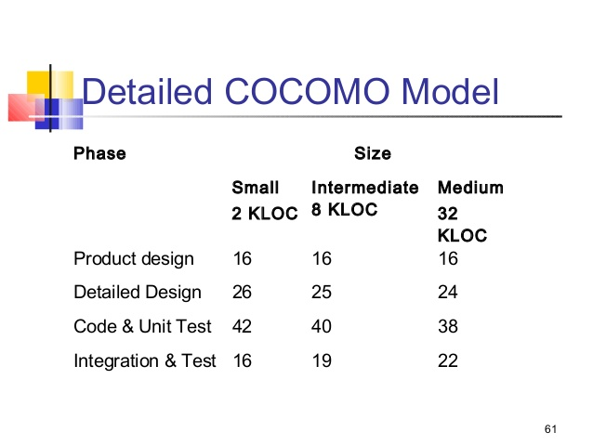
Nilina Bera

Slide 17
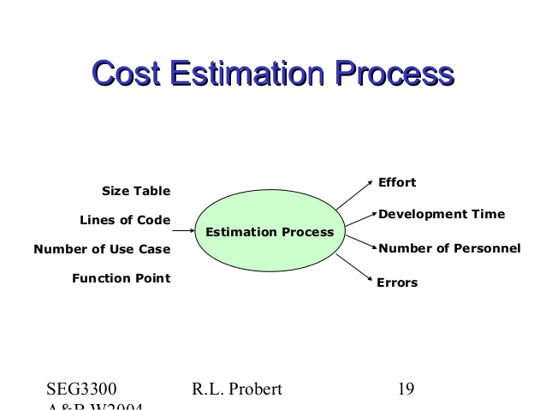
Nilina Bera

